Slide 1
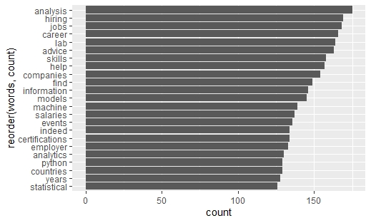
Data from Indeed
We used a web scraper to collect data from Indeed.com on Data Science jobs.
We then evaluated which words were most often used in those job postings.

